Slide 1
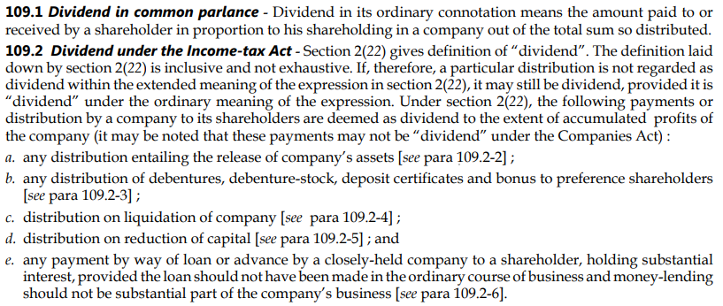
Dividend and Deemed Dividend

Slide 2
Dividend and Deemed Dividend
Domestic Company | 80M deduction
Individual/HUF/Firm | Max 15% surcharge

Slide 3
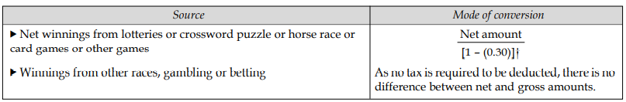
Winning from Lotteries, crossword puzzles, horse races, card games etc.
Gross & net = winning amount was 100000 received only 70000 in my hand
TDS 30% exceeding 10,000

Slide 4
Interest on securities
Gross & net
Due on fixed dates 30 april 30 oct
TDS – 10% rate
No TDS – Govt. Securities(except relief bonds)
Exempt: 10(15):
Interest on notified securities
Interest on post office saving bank account (Rs.3500–individual&Rs.7000–joint account)

Slide 5
Income from Machinery, Plant Furniture let on hire, Composite letting
Taxable

Slide 6
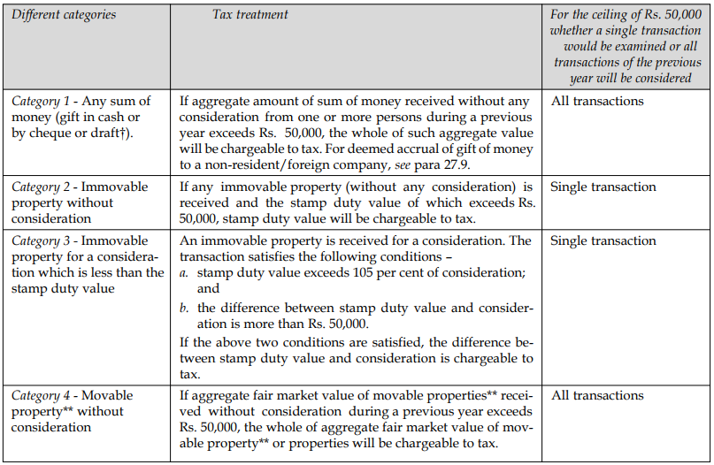
Money / Property received without consideration or inadequate consideration
110

Slide 7
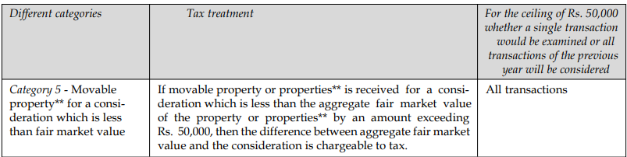
Money / Property received without consideration or inadequate consideration

Slide 8
Money / Property received without consideration or inadequate consideration
Money Cash Gift or Cheque or draft) | Aggregate amt 50000 > | Taxable = full amt
Immovable property without consideration | Stamp duty > 50000 | Taxable = Stamp duty value
Immovable property with consideration | a. Stamp duty > 110% consideration And b. (Stamp duty – consideration) > 50000 | Taxable = Stamp duty – consideration
Movable property without consideration | Agg Fair Market Value > 50000 | Taxable = FMV
Movable property with consideration | (Agg FMV – consideration) > 50000 | Taxable = FMV – consideration

Slide 9
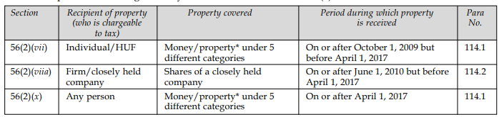
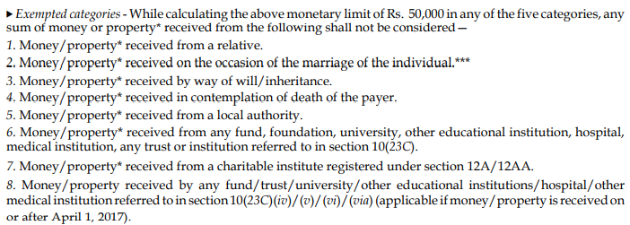

Slide 10
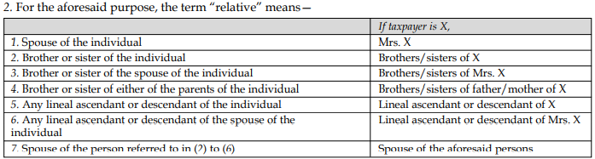

Slide 11
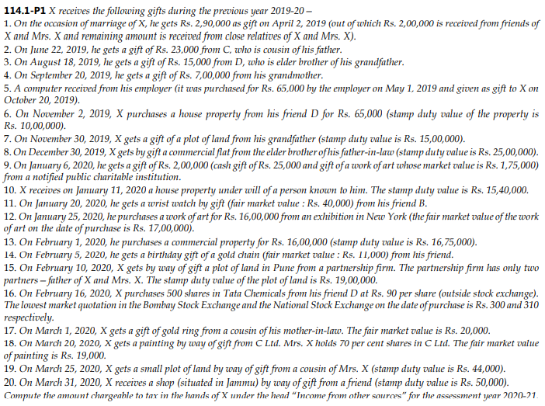
Question

Slide 12
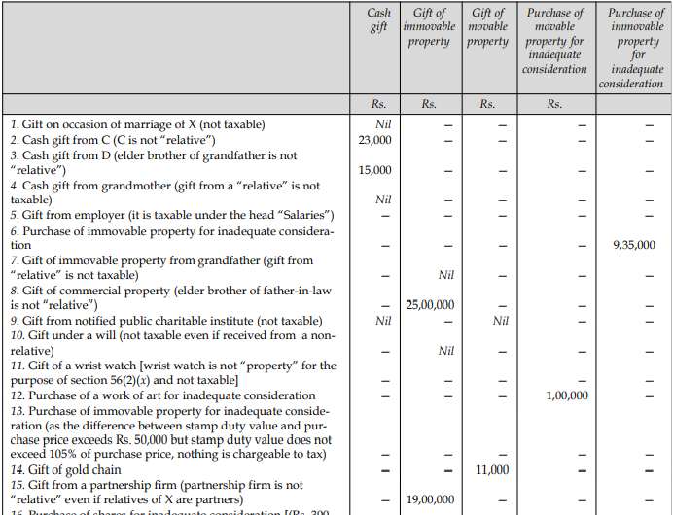

Slide 13
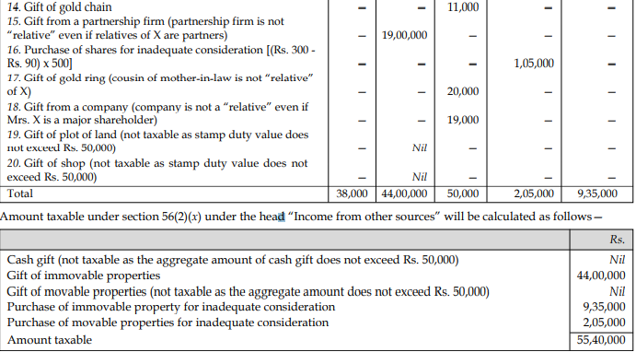
Solution Contd.

Slide 14
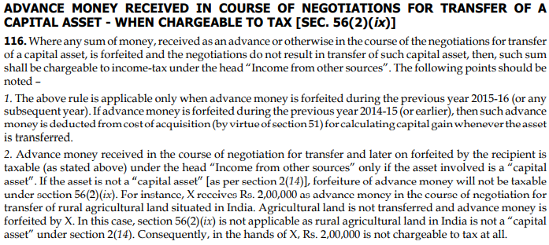

Slide 15
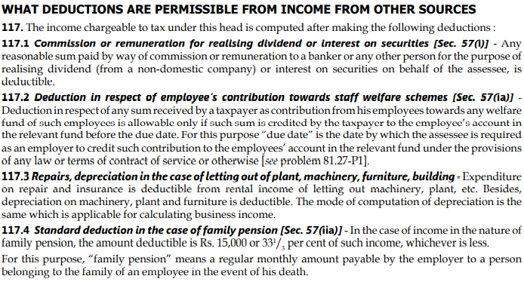

Slide 16
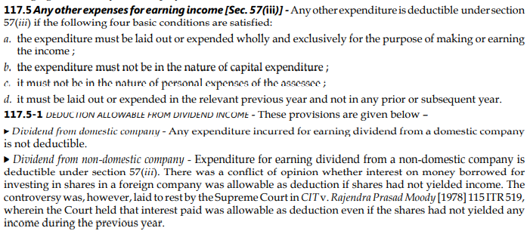

Slide 17
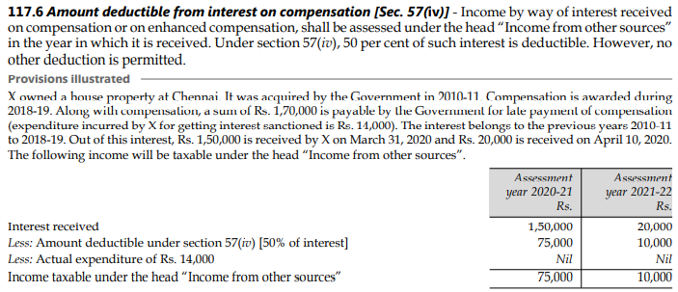

Slide 18
